Slide 1
CSE 445 EDA & Preprocessing
Done by TripleN

Slide 2
Team Members
Name | Id
Nafis Ismam | 2012052042
Mohammad Towfiqul Islam | 2011251042
Tasfia Anan | 2013156042

Slide 3
TABLE OF CONTENTS
01
02
Dataset Insights
EDA - Data Visualization
03
04
Preprocessing
Data Handling

Slide 4
01
Dataset Insights

Slide 5
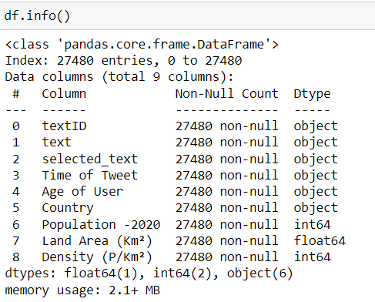
Feature Explanation-
This dataset contains the following 10 fields:
●TextID: Contains the text ID
●Text: Contains the text of the tweet
●Selected text: Contains specific words from within the text
●Sentiment: Positive, negative, or neutral (based on the text)
●Time of Tweet: Contains the time of the tweet
●Age of user: The range of age of the user given
●Country: The country the user tweeted from
●Population: The population of the user’s country in 2020
●Land Area: The land area of the user’s country (in million Km²)
●Density: The population density of the user’s country (in per Km²)

Slide 6
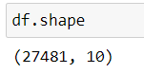
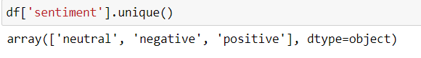
Our dataset contains 10 features in total. The features and it’s Dtype is given in the snippet to the left.
This shows that our dataset contains 27481 rows and 10 columns.
The unique values that the feature ‘sentiment’ can take are positive, negative, and neutral.

Slide 7
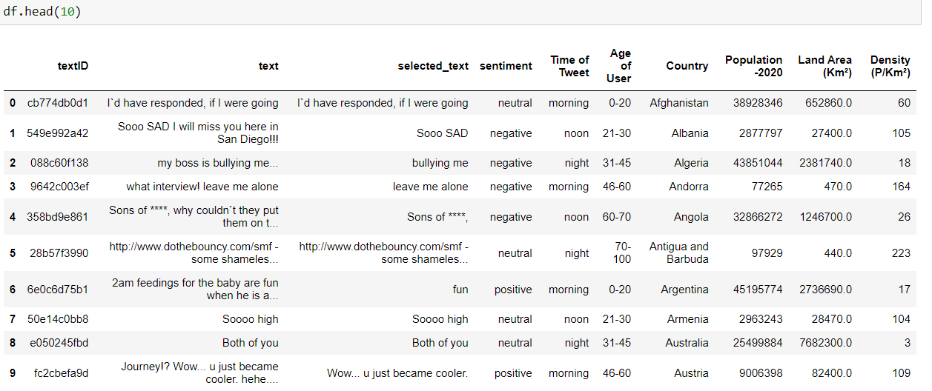
Below is a sample of the first 10 rows of our dataset.

Slide 8
02
EDA - Data Visualization

Slide 9
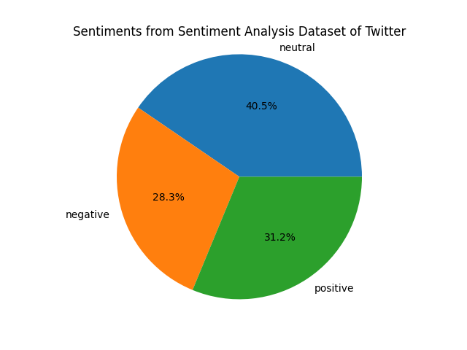
Sentiment Demographic
The following pie-chart shows the percentage of data of each sentiment categories from the Twitter Dataset. Out of 27000 data, most of them were neutral sentiments followed by positive and negative sentiments respectively, as shown in the chart.

Slide 10
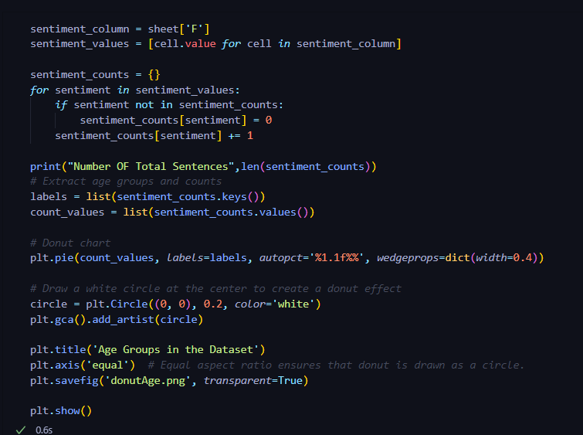
This is the code for generating the pie chart and calculating the percentage of data for each sentiment categories.

Slide 11
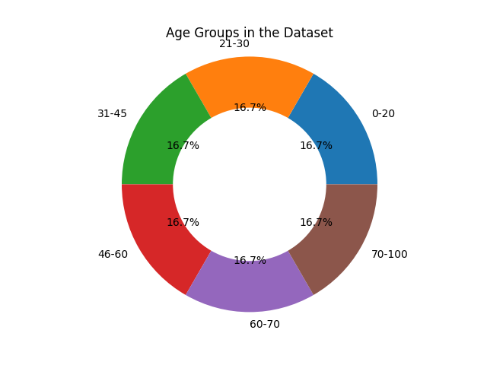
Age Demographic
As you can see from the generated donut chart. There are 6 age groups in our dataset as follows;
0-20
21-30
31-45
46-60
60-70
70-100
And all of them have the same number of data.

Slide 12
Code for generating donut chart and grouping the age groups with their sentiment count as percentage.

Slide 13
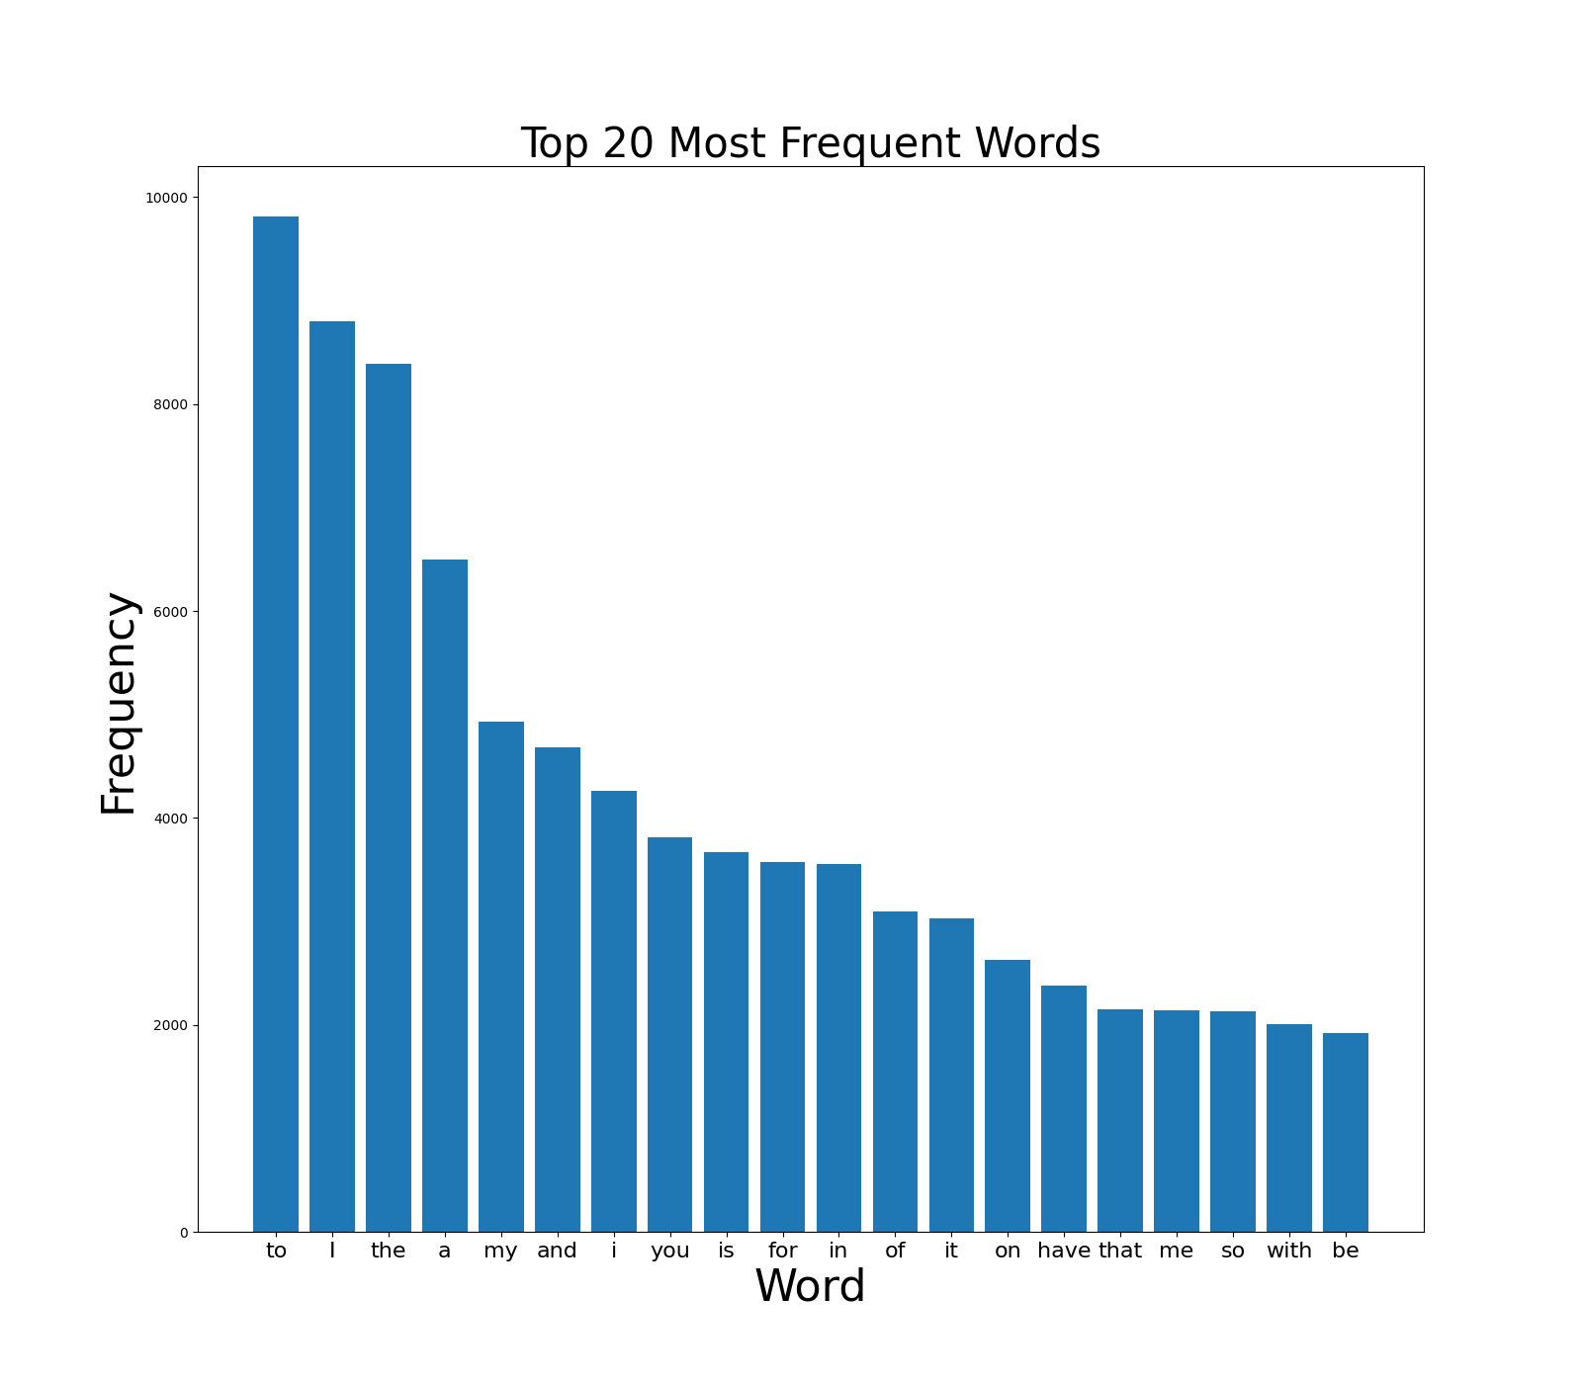
Word frequency Bar Graph
The Frequency of the most used words in the dataset from the text field is visualized.

Slide 14
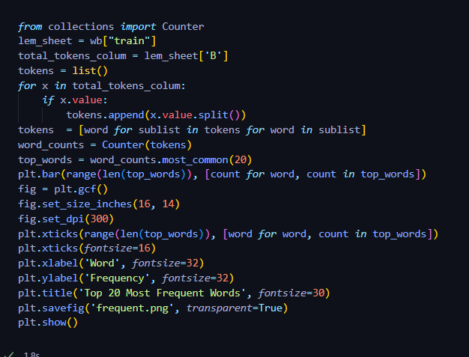
Algorithm to find the frequency of the most used words and visualizing them into a bar graph.

Slide 15
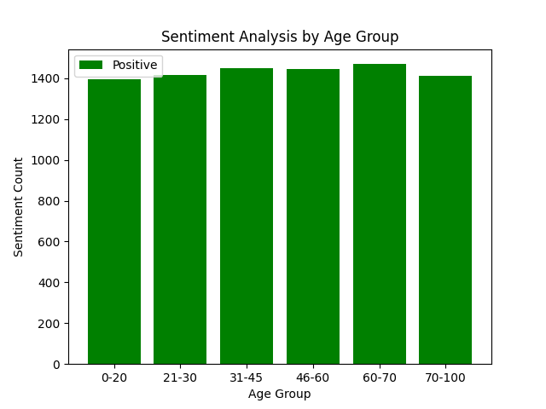
Positive Sentiments in each Age-Group.
This bar graph portrays which age group has the highest positive sentiments. Surprisingly, the 60-70 age group has the most positive sentiments.

Slide 16
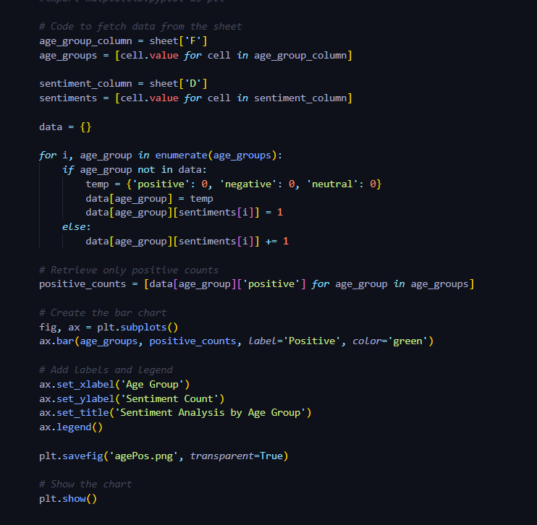
In this code we only retrieved the positive sentiments from each age groups. After that we generate the bar graph with Sentiment Count in y-axis and Age Group in x-axis.

Slide 17
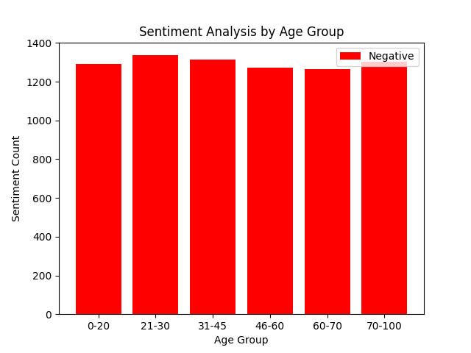
Negative Sentiments in each Age-Group.
Similarly, like the previous graph we have visualized the negative sentiments on each group. It shows that the 21-30 age group has the most Negative sentiments.

Slide 18
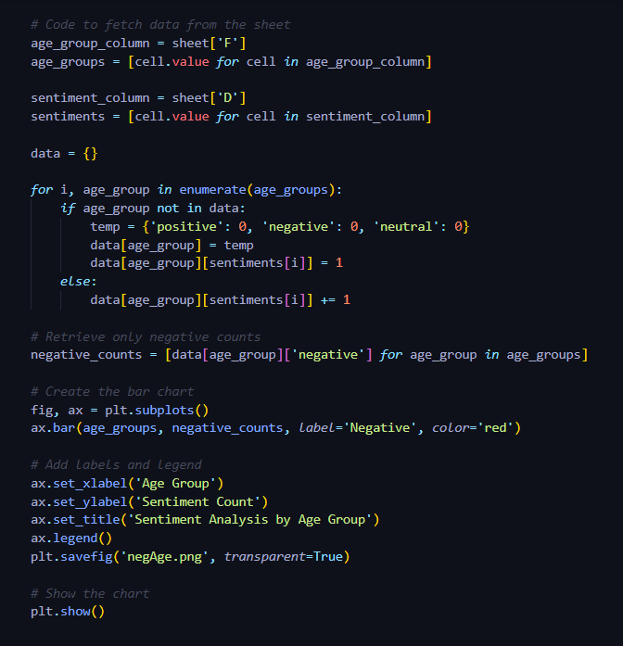
The code implementation was also same just for some small tweaks and changes in the variables.

Slide 19
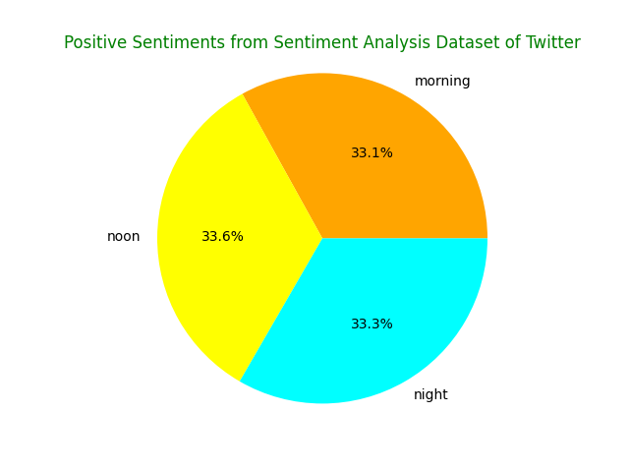
Positive Sentiments during time of Day.
This pie chart shows which time of the day had the highest positive sentiment percentage. As we can see here that, at noon, highest percentage of positive sentiments were obtained.

Slide 20
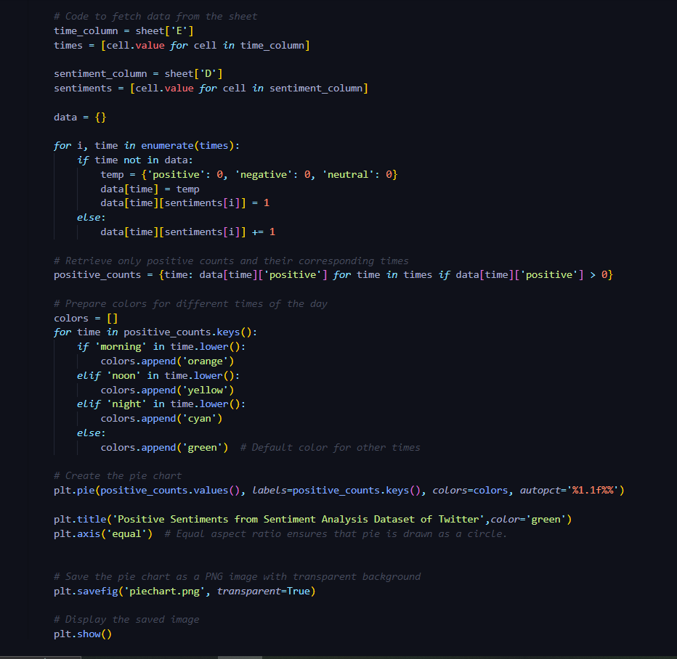
In this code we searched for the similar positive counts like before but in a different column of data which is the ‘Time of Day’ column. Then we assigned different colors to different times for distinguishing them differently.

Slide 21
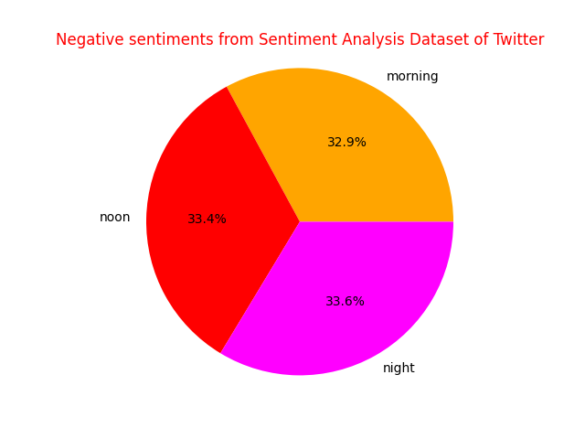
Negative Sentiments during time of Day.
This pie chart shows which time of the day had the highest positive sentiment percentage. As we can see here that, at noon, highest percentage of positive sentiments were obtained.

Slide 22
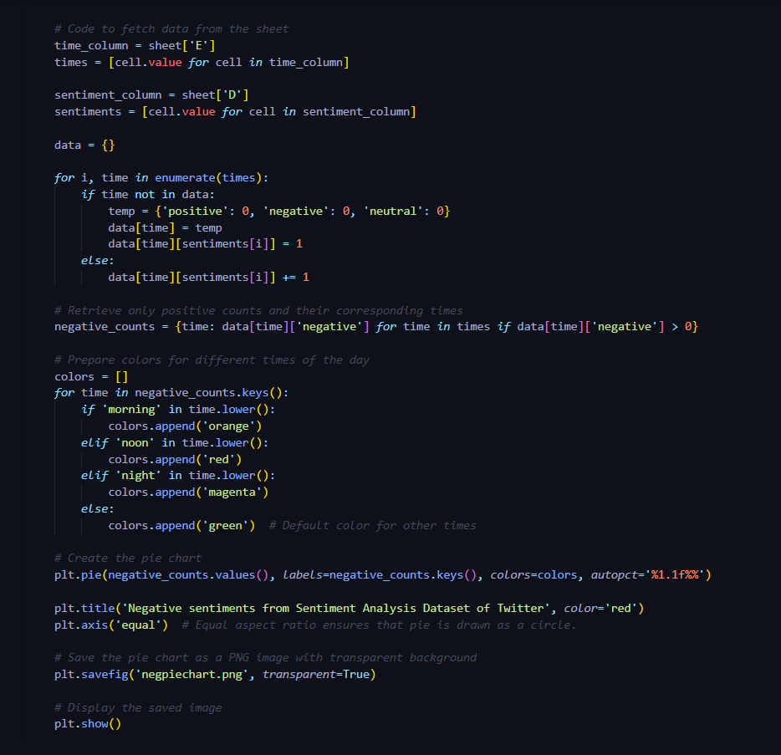
In this code we searched for the negative counts like before but in a different column of data which is the ‘Time of Day’ column. Then we assigned different colors to different times for distinguishing them differently.

Slide 23
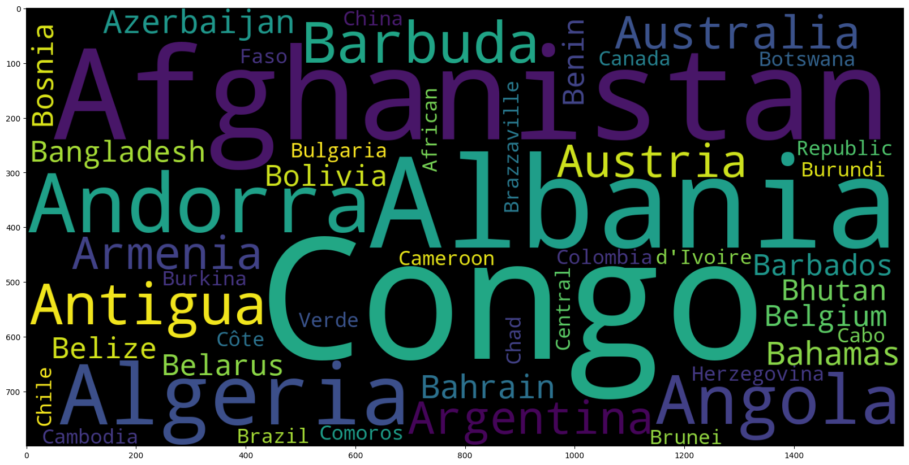
Country with most tweets.
We used wordcloud library which is a graphical representations of word frequency that give greater prominence to words that appear more frequently in a source text. Here the country with the high frequency has it’s name represented in larger text and vice versa.

Slide 24
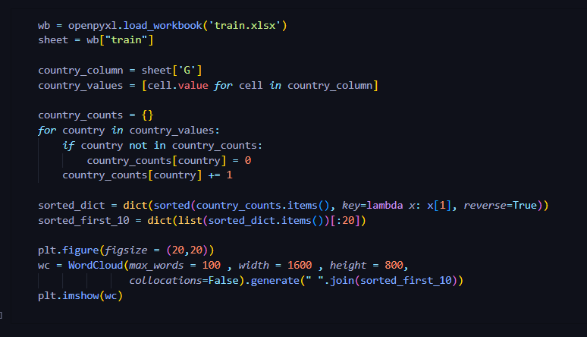
Implemented code for this graphical representation. As there are a total of 189 countries in this dataset. For instance, we only showed the top 20 countries with the highest frequencies in this dataset.

Slide 25
03
Data Preprocessing

Slide 26
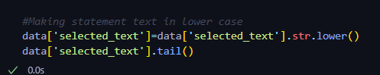
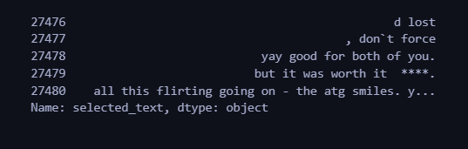
Lowercasing Text
All the text converted to lower case letters for making it easier for the model while training.
Code
Output

Slide 27
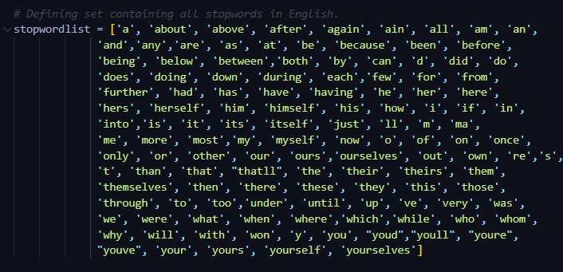
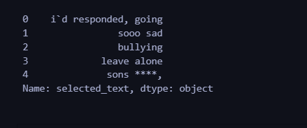
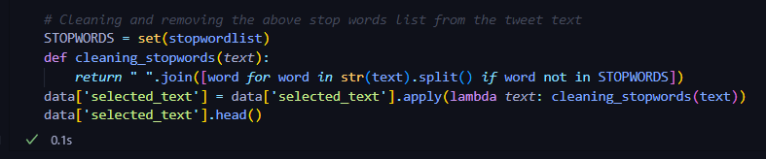
Stopword Removal
Output
Code

Slide 28
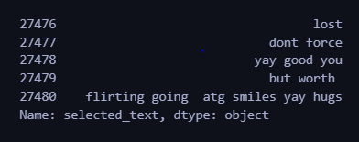
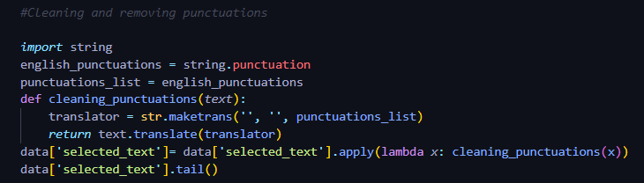
Punctuation Removal
Output
Code

Slide 29
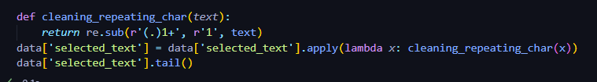
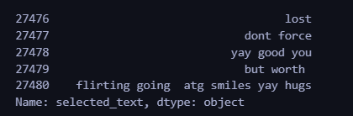
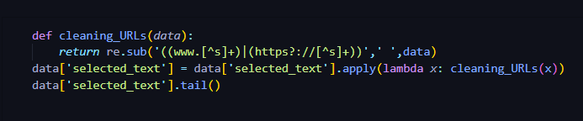
Removing Repeated Characters & URLS
Code
Output
Code

Slide 30
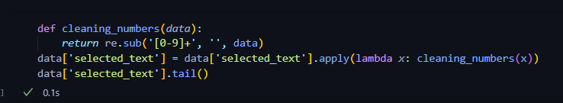
Removing Numbers
Code
Output

Slide 31
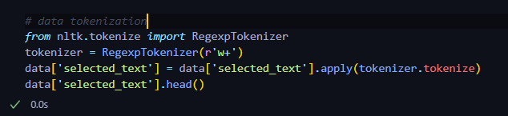
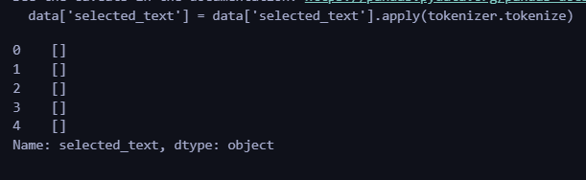
Tokenization
Code
Here we used the Natural Language Toolkit (NLTK) to split paragraphs and sentences into smaller units that can be more easily assigned meaning. The first step of the NLP process is gathering the data (a sentence) and breaking it into understandable parts (words).
Output

Slide 32
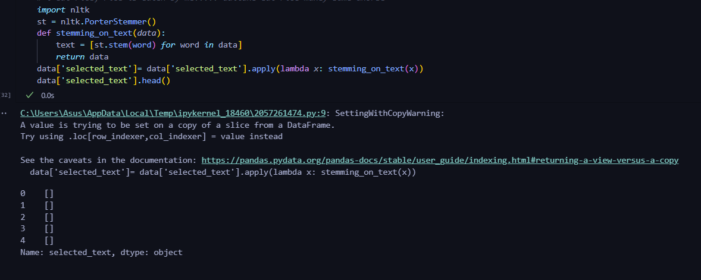
Stemming
We use the same NLTK library for stemming which is the process of reducing a word to its stem that affixes to suffixes and prefixes or to the roots of words known as "lemmas". Stemming is important in natural language understanding (NLU) and natural language processing (NLP).
Code
Output

Slide 33
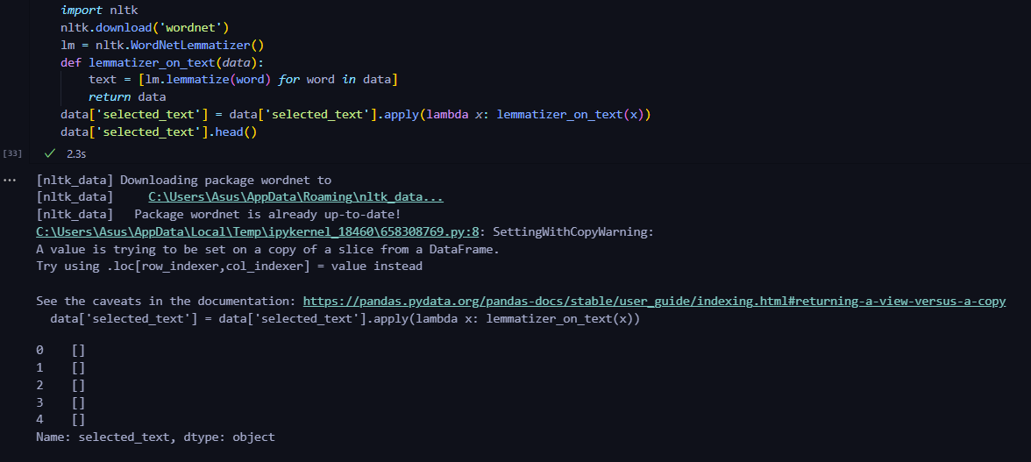
Lemmatization:
By NLTK Lemmatization we grouped the inflected forms of a word in order to analyze them as a single word in linguistics. Lemmatization is preferred over Stemming because it is a contextual analysis of words instead of using a hard-coded rule to chop off suffixes.
Code
Output

Slide 34
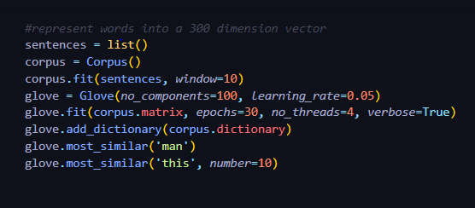
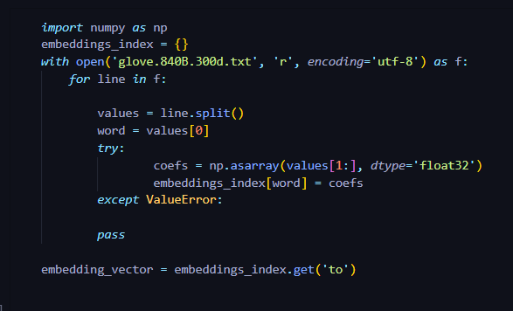
Word Embedding
Word Embeddings in NLP is a technique where individual words are represented as real-valued vectors in a lower-dimensional space and captures inter-word semantics. Each word is represented by a real-valued vector with tens or hundreds of dimensions. For word embedding we used Glove which stands for global vectors for word representation. It is an unsupervised learning algorithm developed by Stanford for generating word embeddings by aggregating global word-word co-occurrence matrix from a corpus. The resulting embeddings show interesting linear substructures of the word in vector space.

Slide 35
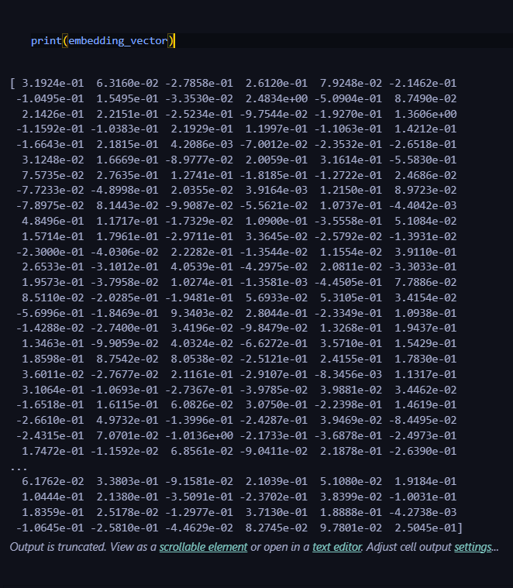
Output
Embedded Vector of the word ‘to’ generated into 300 dimensions.

Slide 36
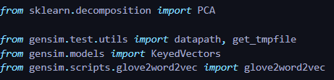
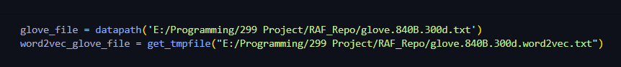
Word Embedding with Word2Vec
**As mentioned in related research paper**
Code
Used the Stanford Glove Word Embedding Unsupervised

Slide 37
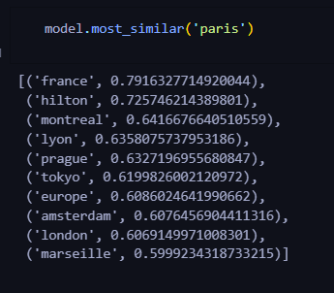
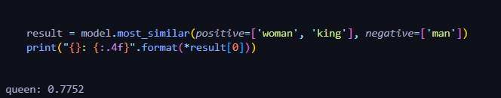
Word2Vec is a popular word embedding technique used to represent words as dense vectors in a high-dimensional vector space. It is a shallow, two-layer neural network model that takes a large corpus of text as input and learns to assign vector representations to words based on their co-occurrence patterns within the text.
Here we used it for finding the closest Value of vectors of the given word as shown in the snapshot provided below (left side). It finds the closest Vectors to the value of Paris, as Paris word contains 300D vector, this finds the other words who's Vectors difference is minimum.
The snapshot on the right We just did some vector math, with the women Vector + king Vector we Subtracted the Man vector this creates a new vector with 300D values and the closest vector to that value is Queen.
Output

Slide 38
04
Data Handling

Slide 39
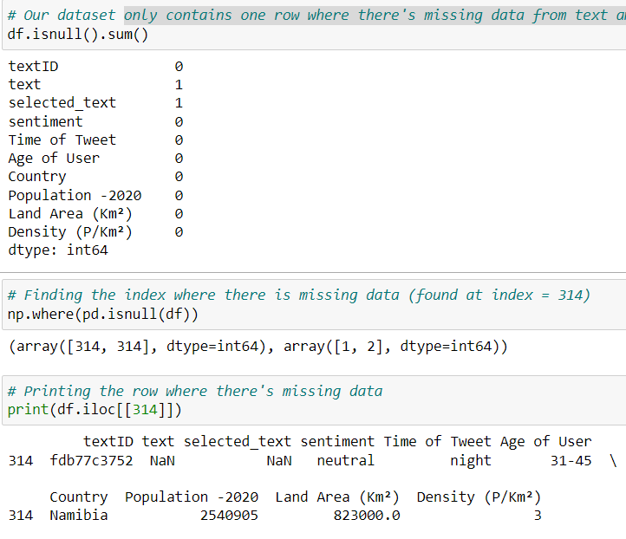
Missing data handling-
Our dataset contains only one row where there's missing data from ‘text’ and ‘selected_text’ features, as we can see from the snippet on the left.
For this reason, we thought of excluding that particular row from our dataset, as dropping 1 row won’t really affect the performance of our model, as we will still have 27480 rows of data, which is ample.
We first found the row’s index where there’s missing data (as shown on the left), then dropped that row (shown in the next slide).

Slide 40
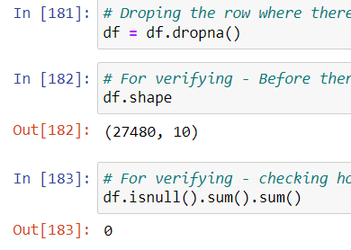
Here, the row has been dropped.
After dropping the row, we can see that the row count is 27480 instead of 27481.
Finally, the total number of missing data now is 0 (as shown in the snippet on the left).

Slide 41
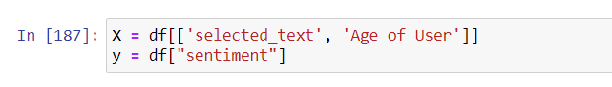
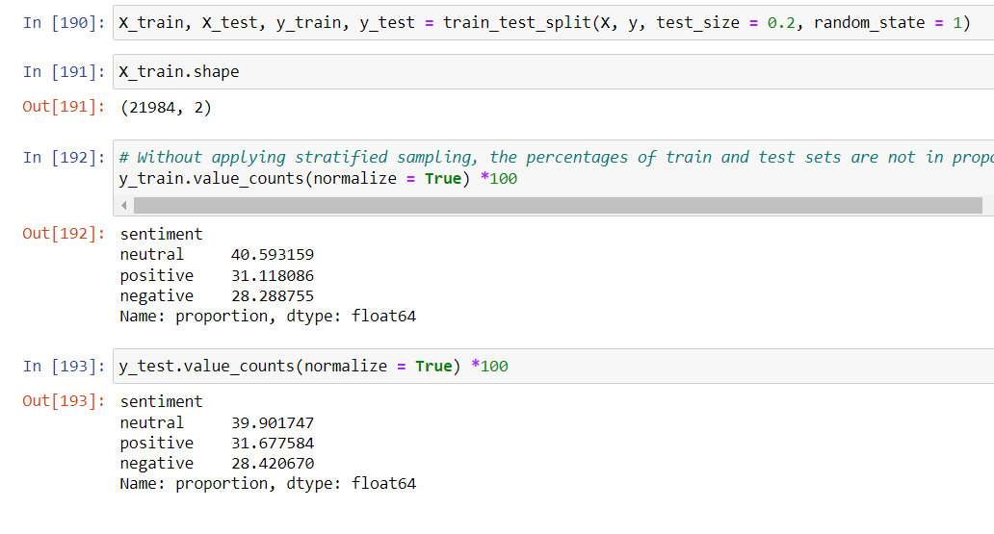
Stratified sampling on imbalanced class
Problem?
Without stratified sampling, our dataset for the output (which is the ‘sentiment’ feature), gives different percentages for train and test sets (as we can see from the snippets on the left). The training and test sets are not in proportion.
For the training set, we can see that for the percentage of negative values is 28.2%, while for testing set, the percentage is 28.4%. This means that our model won’t get be getting quite as many negative values to get trained with.

Slide 42
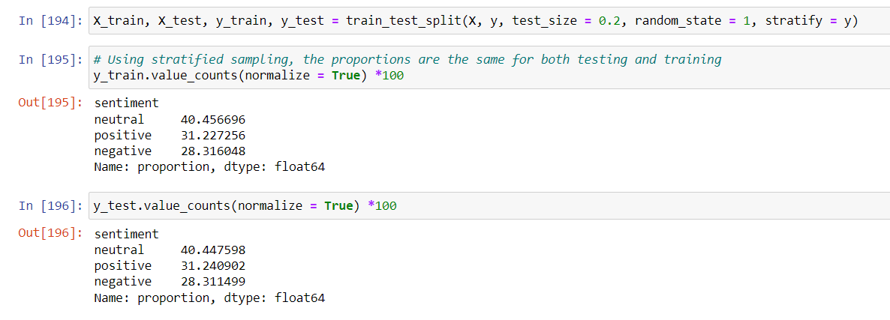
Solution-
To solve the problem, we use stratified sampling. Using stratified sampling, the proportions are the same for both testing and training sets.
Example- for the negative value, the percentages are almost same for both the training and test sets (28.3%).

Slide 43
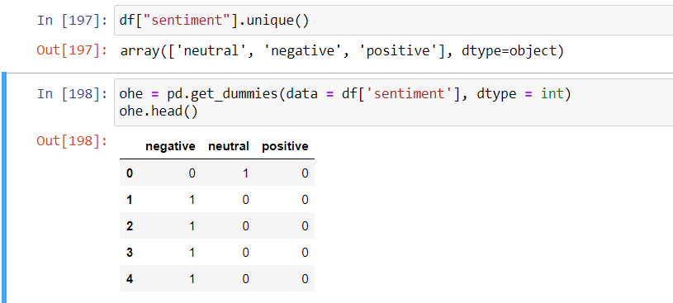
One Hot Encoding
One hot encoding is used to represent the categorical feature, which in our case is ‘sentiment’, as numerical data.
Allows for greater accuracy for the model.

Slide 44
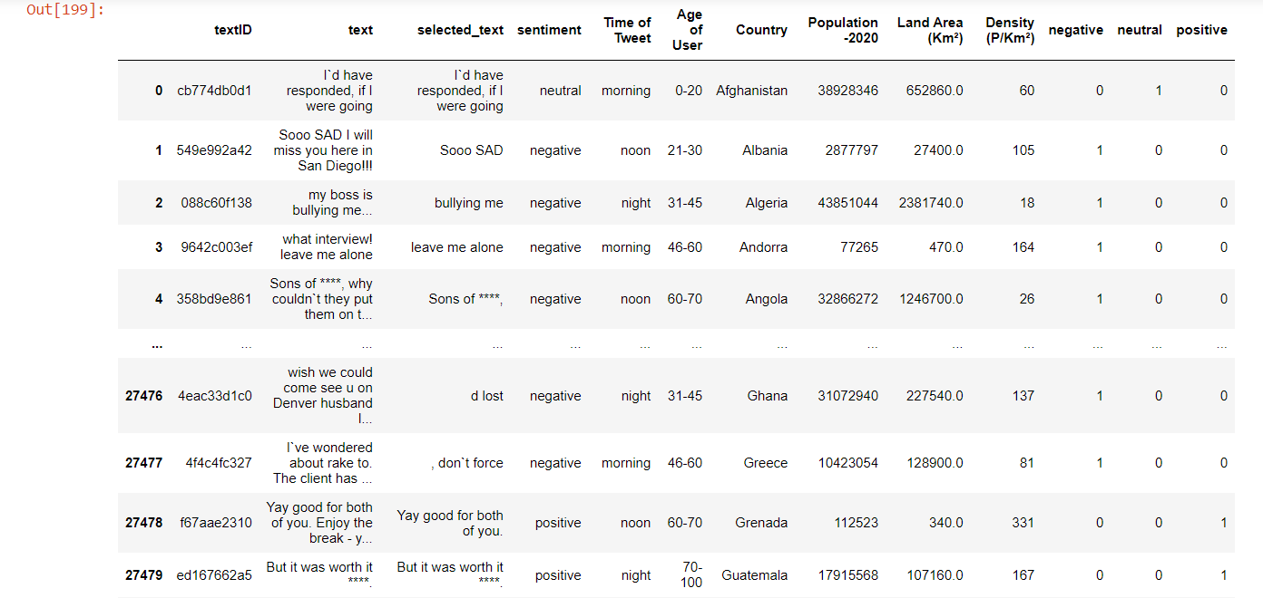
3 new columns added at the end of the dataframe, referring to the 3 values of the feature ‘sentiment’.

Slide 45
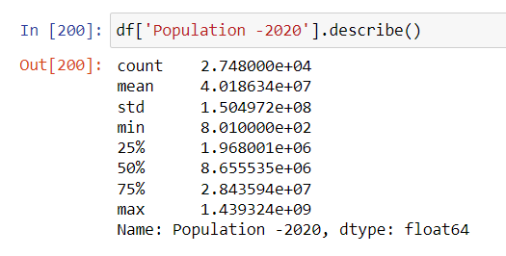
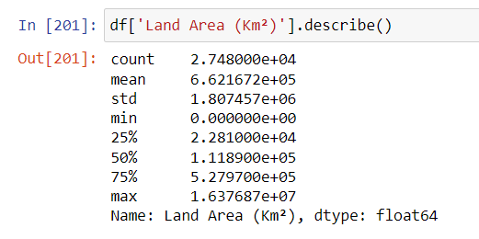

Normalization
To avoid biasing by the Machine Learning model, it’s necessary to bring all the numerical features to the same scale. For our purpose, we have used normalization technique.
We will normalize the features ‘Population -2020’, ‘Land Area (Km²)’, ‘Density (P/Km²)’, as the values of these features are very spread out.

Slide 46

After normalization, the values of the selected features came in the range of 0 to 1 (as shown in the snippet above). Column ‘0’ refers to ‘Population -2020’, column ‘1’ refers to ‘Land Area (Km²)’, and column 2 refers to ‘Density (P/Km²)’.

Slide 47

Balancing technique (Undersampling)
Problem?
Our dataset contains 7781 negative values (which is slightly less than the other values). This may result in the model not getting equally trained for negative values compared to neutral and positive values.

Slide 48

Solution-
We used undersampling. After applying this technique, the values for each category (i.e positive, negative, neutral) are equal, as shown in the screenshot to the left.
Now the model will get equal values of ‘positive’, ‘negative’, and ‘neutral’, resulting in a better accuracy.

Slide 49

Feature dropping-
Dropping ‘Population -2020’, ‘Land Area (Km²)’, ‘Density (P/Km²)’, as they are irrelevant.

Slide 50
05
Models

Slide 51


Model 1: BNB

Slide 52


Slide 53


Model 2: COUNT DICT

Slide 54


Slide 55


Model 3: Logistic Regression

Slide 56


Slide 57


Model 4: LSTM

Slide 58


Slide 59

Model 5: BERT

Slide 60

Bar Chart comparing the different model’s accuracy

Slide 61



Pie Charts comparing the model’s accuracy, precision, and recall scores

Slide 62
Comparison table
 | Accuracy | Precision | Recall
LSTM | 0.43 | 0.43 | 1.0
Logistic Regression | 0.87 | 0.87 | 0.69
BNB | 0.72 | 0.94 | 0.14
BERT | 0.80 | 0.79 | 0.81
COUNT DICT | 0.86 | 0.81 | 0.73

Slide 63
Dataset link-
https://www.kaggle.com/datasets/abhi8923shriv/sentiment-analysis-dataset

